Slide 1
Low Cost Iot Driven Smart Agro-Drone for Early Detection of Late Blight Disease of Potato
A smart crop health monitoring system for early detection of plant disease

Slide 2
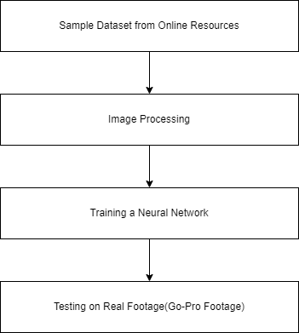
Prototype Pipeline

Slide 3
Open-Source Dataset
For this study, three major sources of information are considered, each of them featuring
complementary and characteristic features useful to design, test and monitor crop health.
The top open source datasets that are referenced are as follows:-
1. Kaggle
2. Mendeley Data
3. Harvard Dataverse
These datasets provide a variety of data samples across different environments covering
various plant disease records.

Slide 4
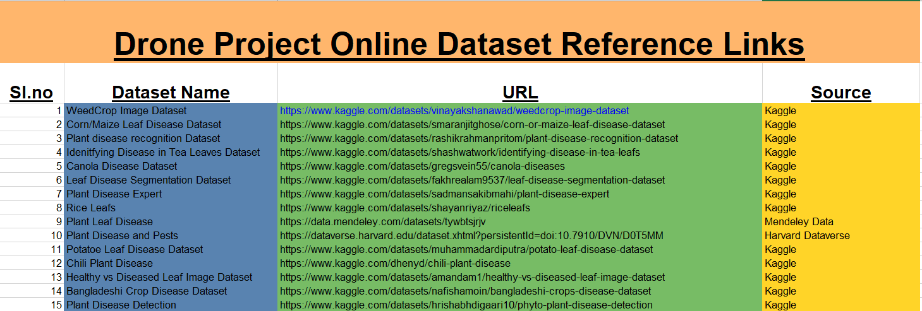
Open-Source Dataset List

Slide 5
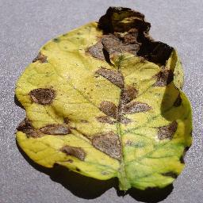
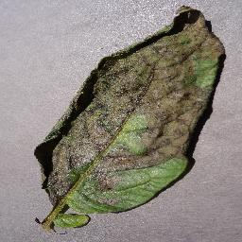
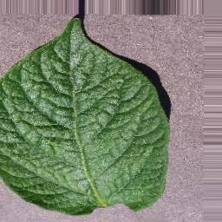
Open-Source Dataset Sample
Early Blight
Late Blight
Healthy Sample

Slide 6
Prototype Requirement
List of items required for prototype
Go-Pro Hero 8
Land-area to grow crops(potatoe)
Basic Cultivation Items

Slide 7
Future Aspects
Implementation of automatic controlled footage capturing using IoT driven Drone.
Real-Time Analysis Report to the Land Owners through Web-Apps.
Optimization of the footage captured.
IoT driven Drone to be used for a longer amount of time.

Slide 8
THANK YOU!

